Slide 1
Project One:
A dive into the Google Play Store
Emmanuel Fabre
Aaron Zhou
& Greg Leland

Slide 2

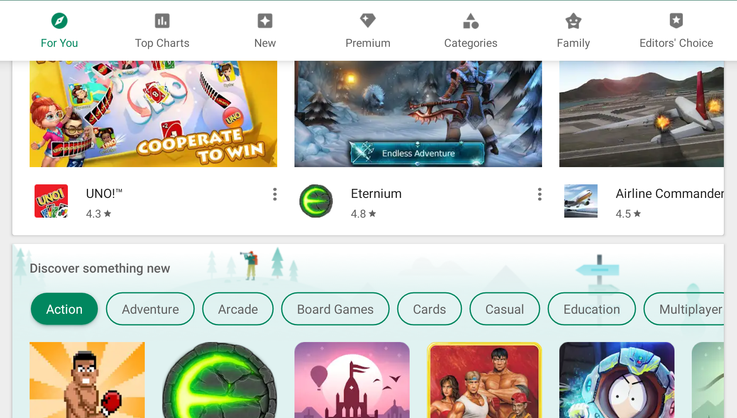

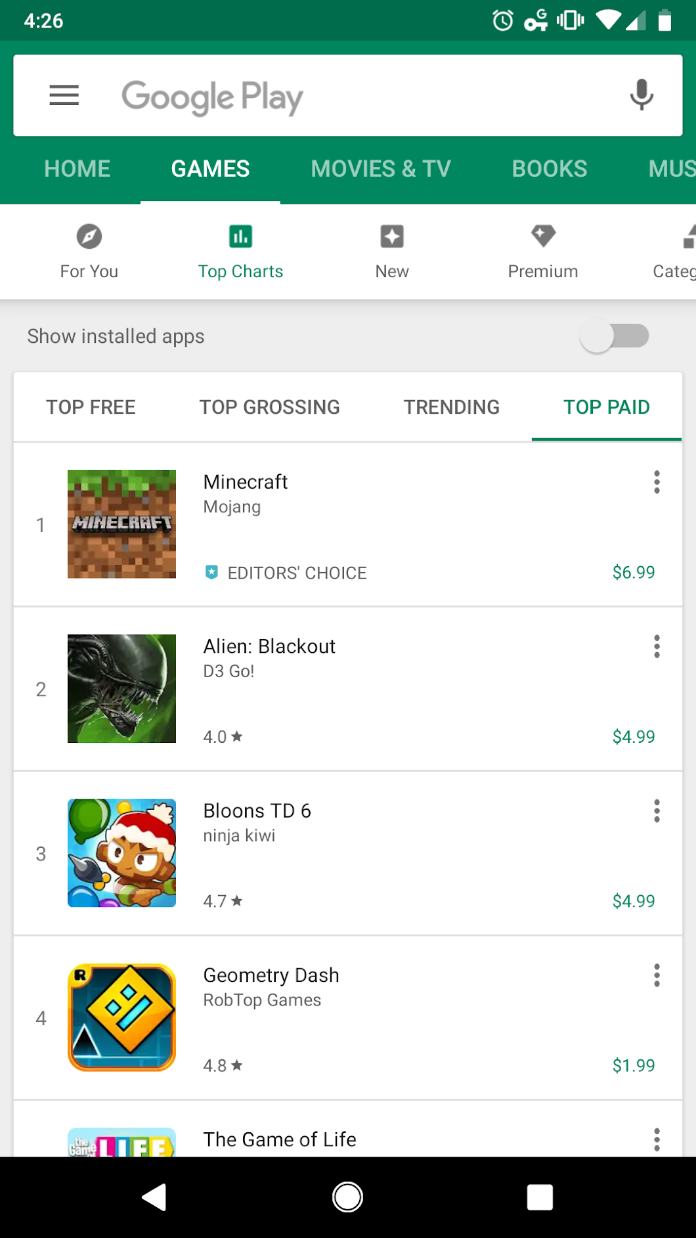
Our
Scenario:
We were hired as data scientists by a small startup game production company that has a budget of $150k to spend on their first Android mobile game. To maximize return on their investment, they want to know what type of game to develop, and how much they should charge to maximize profit (via paid downloads).

Slide 3
Our Hypothesis:
If they develop a game in a specific category, at a specific price point, they will have an increased likelihood of success.

Slide 4
Our Process...
Collecting,
Cleaning,
& Sorting
Data
Problem
Solving
Analysis
Conclusion

Slide 5
Main Questions:
What is the optimal game category (Arcade, Action, Racing, Simulation, etc)?
What is the optimal price point?
Does the game’s rating score have an impact on the game’s success?

Slide 6
Our Limitations:
Problems 1 & 2:
The majority of mobile games are free. They make revenue via ads and ‘microtransactions’ (a.k.a. in-game purchases). Because we don’t have access to the data on revenue generated from free games, we were limited to coming to conclusions based on available information for paid games. Google doesn’t have an official API to get the information from the Play Store directly, which made things a bit difficult.
Our Solution:
We got lucky and found a Python library on PyPi.org called, “Play Scraper”. It functions as an API, and combs through the Google Play Store’s website by using variables in Python. Luckily, it was able to get enough information to deliver a plausible conclusion to our ‘employers’.

Slide 7
Our Limitations (continued):
Problem 3:
Limited information on the Google Play Store made it impossible to get an exact download amount for each game.
Our Solution:
Because the Google Play Store gives an approximate number of downloads (in 5k, 10k, 50k, 100k, 500k, 1M, & 10M increments), we were able to use the ‘number of installations’ as our source for generating approximate revenue for each game, which was able to provide adequate data for our analysis.

Slide 8
Let’s get to coding!

Slide 9
Steps We Took:
Installed the Play Scraper library.
Created a loop that would find the top 25 paid games in all gaming categories on the Google Play Store.
We took the app/game ID’s from the top 25 games in each gaming category, and pulled the following information for our research:
The game’s Title
The game’s rating
The amount of reviews for each game
The price of each game
The approximate amount of installations/purchases each game has
The game’s developer
The link to the game on the play store for reference
We then took all the information and put it into multiple data frames so we could access the info and answer our questions.

Slide 10
“Under the hood”
How we got our data and what we did with it.

Slide 11
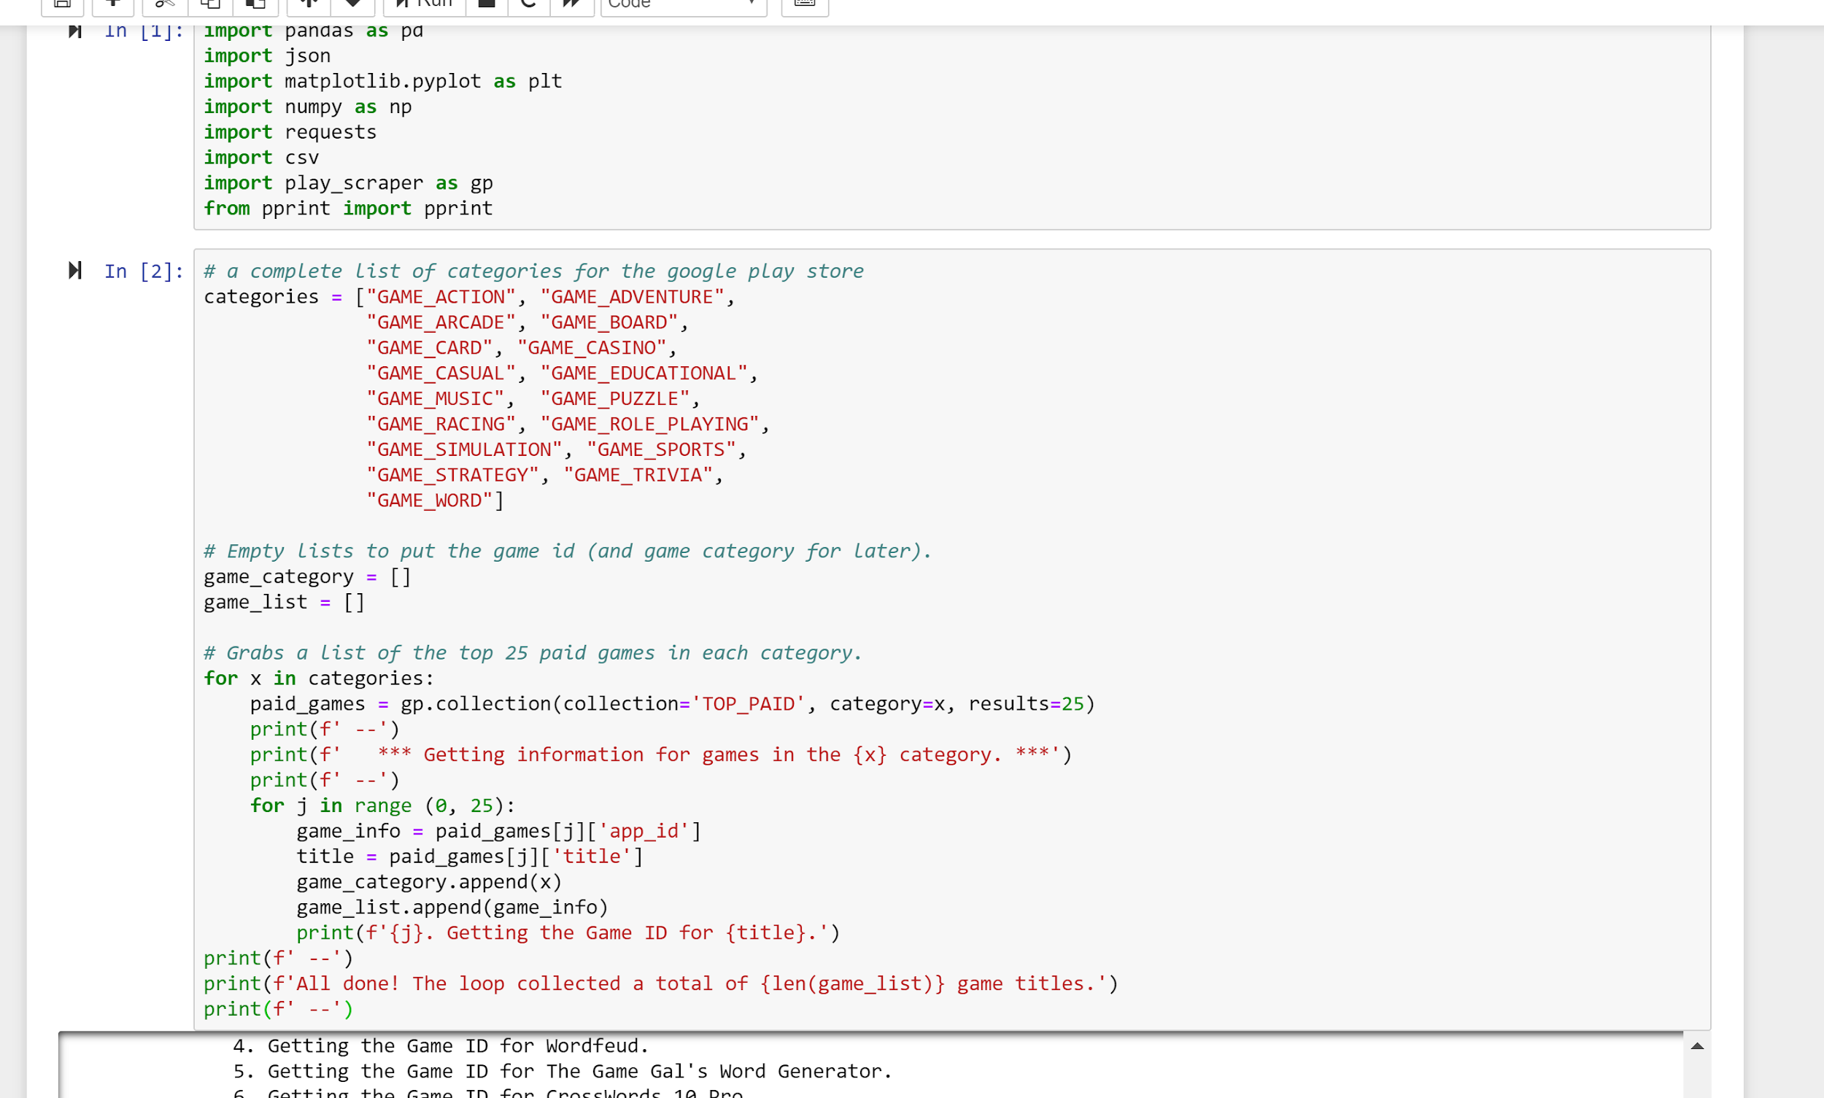
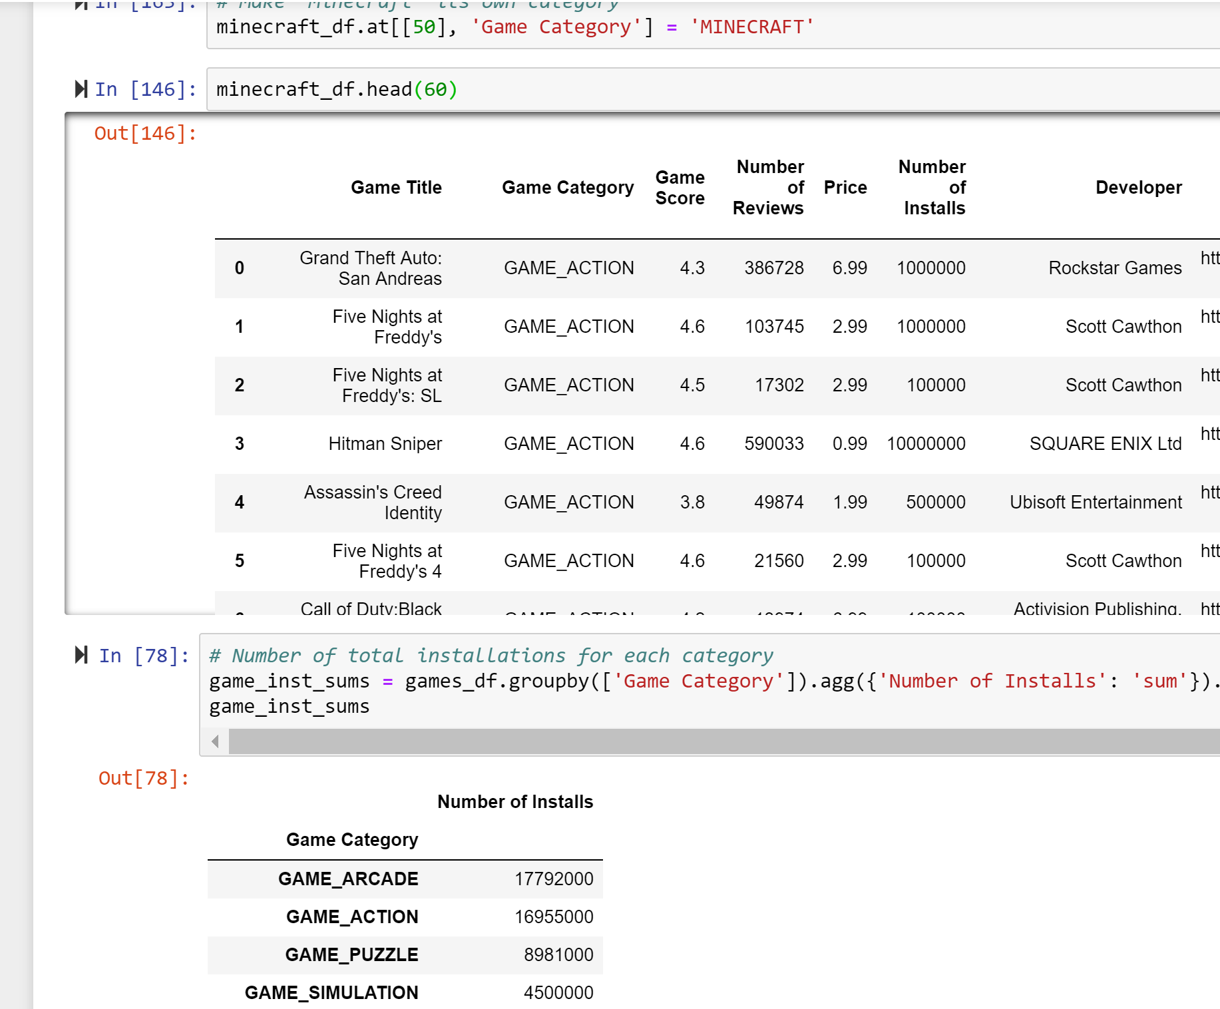
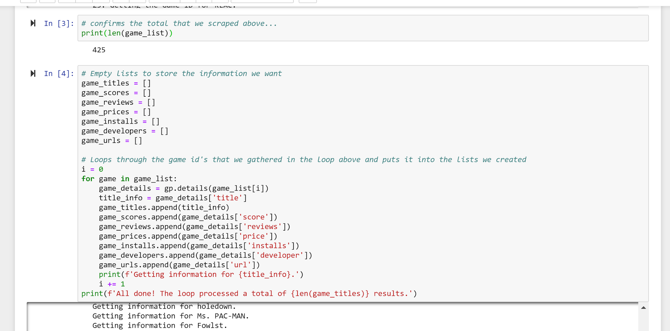
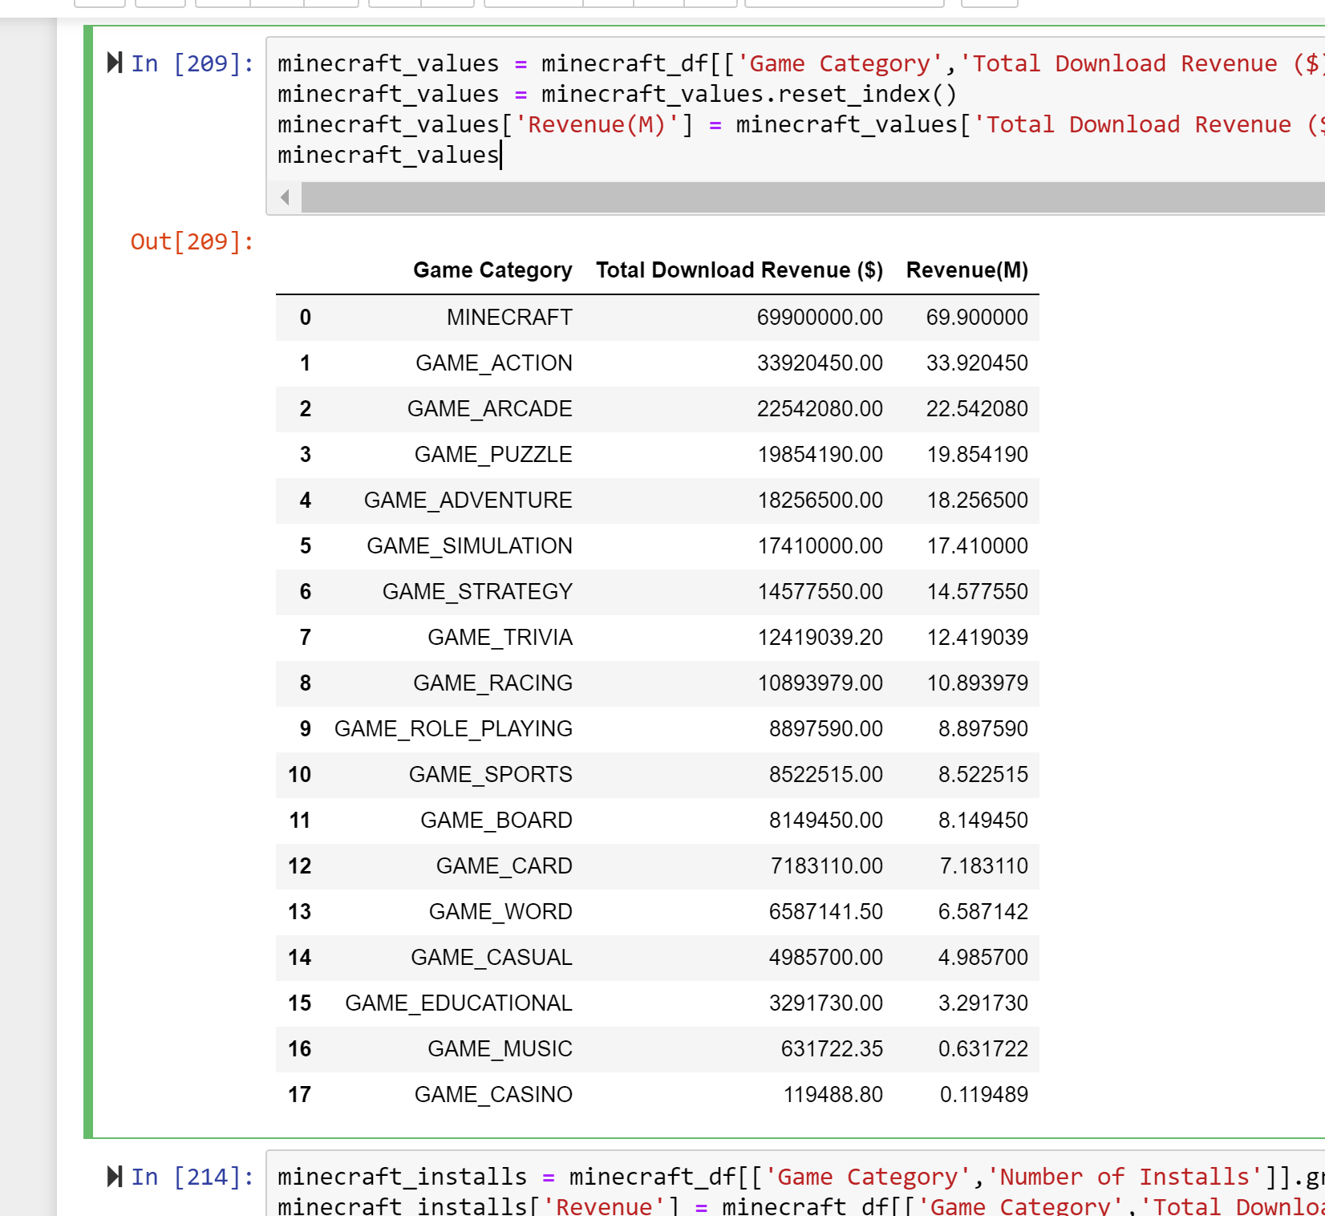
Examples of
Our Code

Slide 12
Here’s what we found...

Slide 13
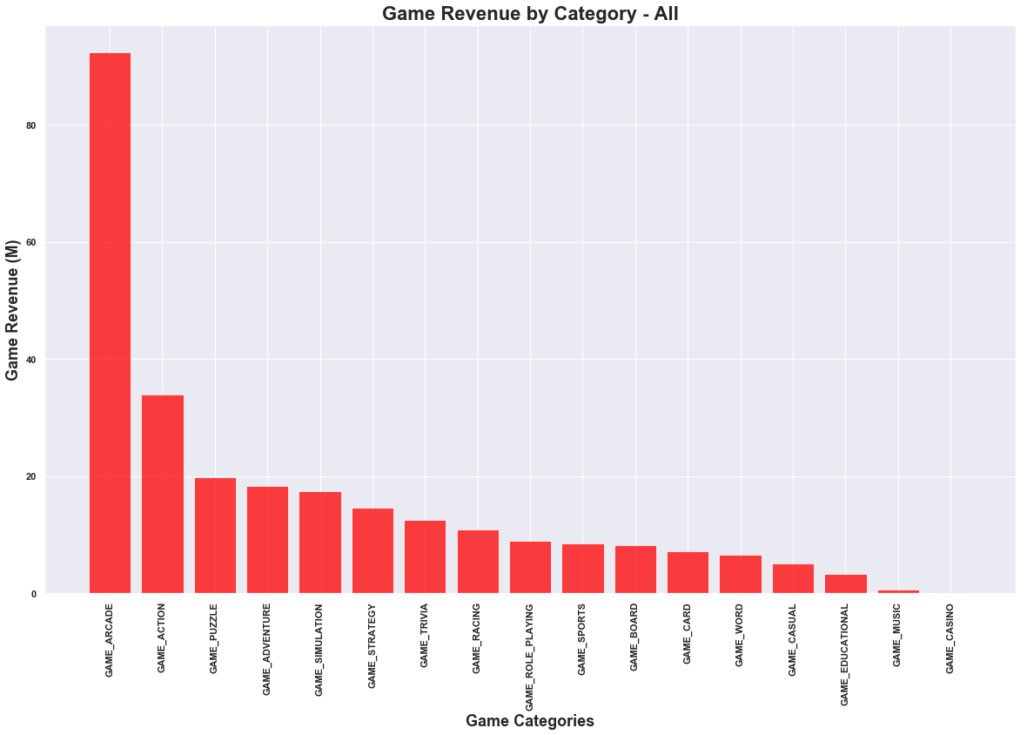
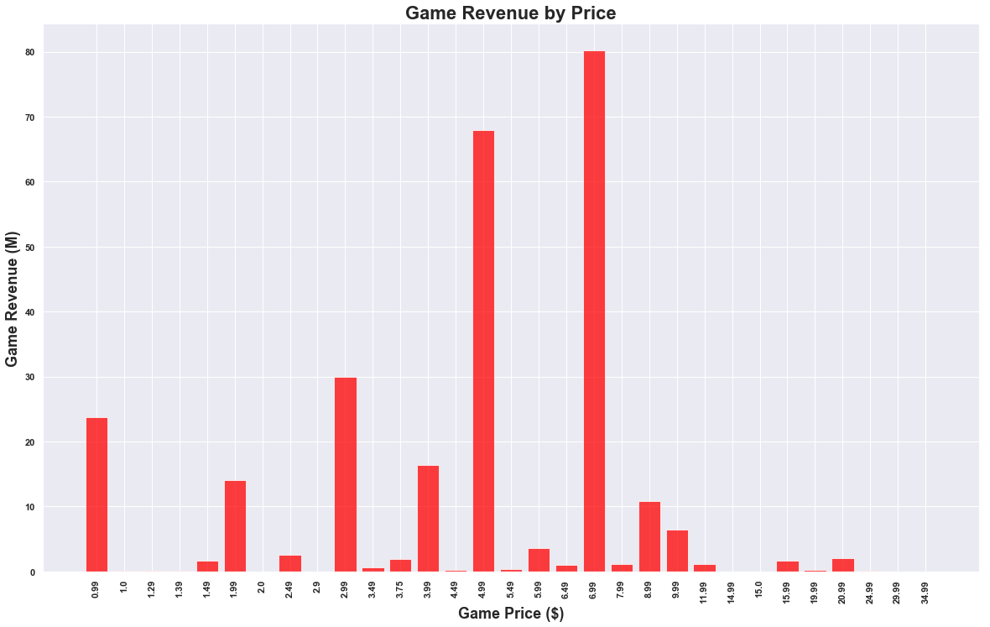
Game Revenue by Category
Game Revenue by Price
This bar graph shows that the ‘Arcade Game’ category was, by far, the highest grossing category in the Google Play Store. Could there be an outlier?
This bar graph shows the total revenue by price point, and the $6.99 price point seems to show a similar trend. We looked into it, and found something very interesting...

Slide 14
Minecraft accounted for a total of $69,900,000 of revenue BY ITSELF.
We separated Minecraft from the
rest of the categories, made it its own category, and then graphed the revenues by category again.

Slide 15
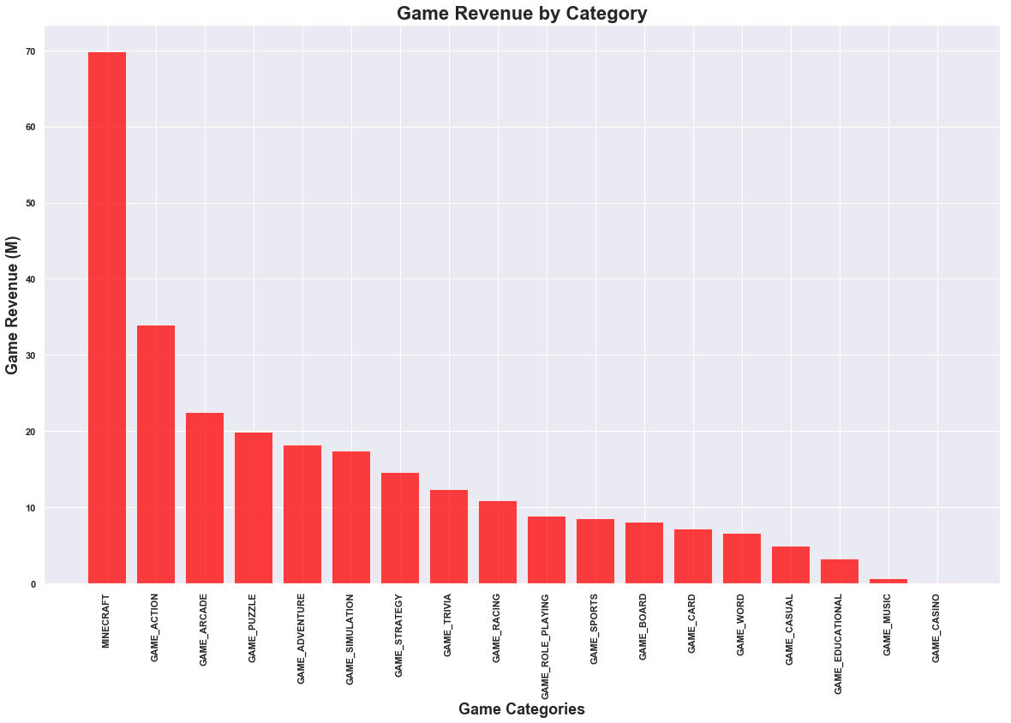
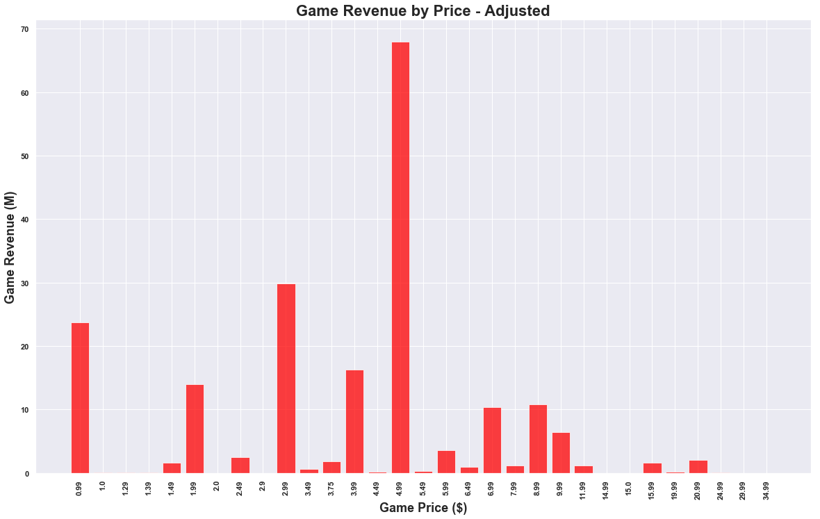
Game Revenue by Category
Game Revenue by Price
Minecraft grossed more than the top 2 gaming CATEGORIES COMBINED. With it removed from the Arcade category, Action was the highest grossing overall.
This bar graph shows the adjusted total revenue by price point after dropping Minecraft from the data frame. The highest performing price point was $4.99.

Slide 16
Do reviews matter?

Slide 17
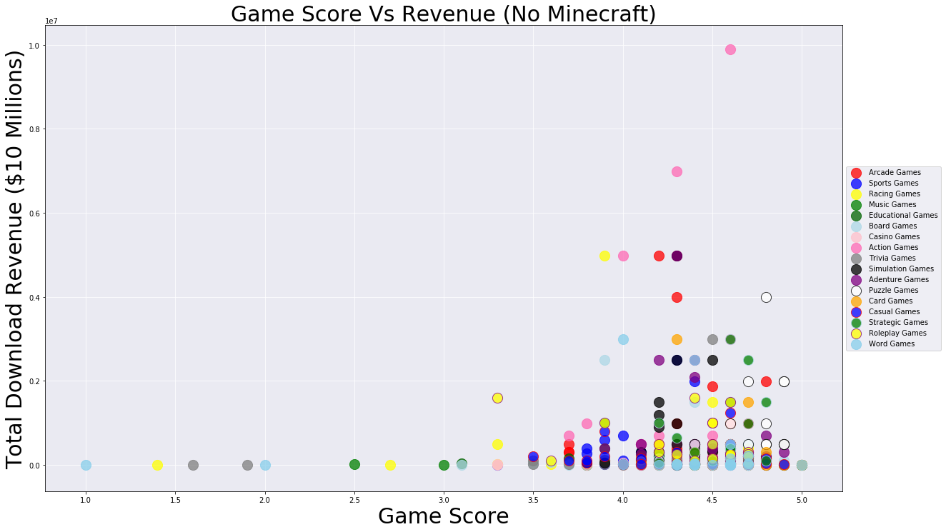
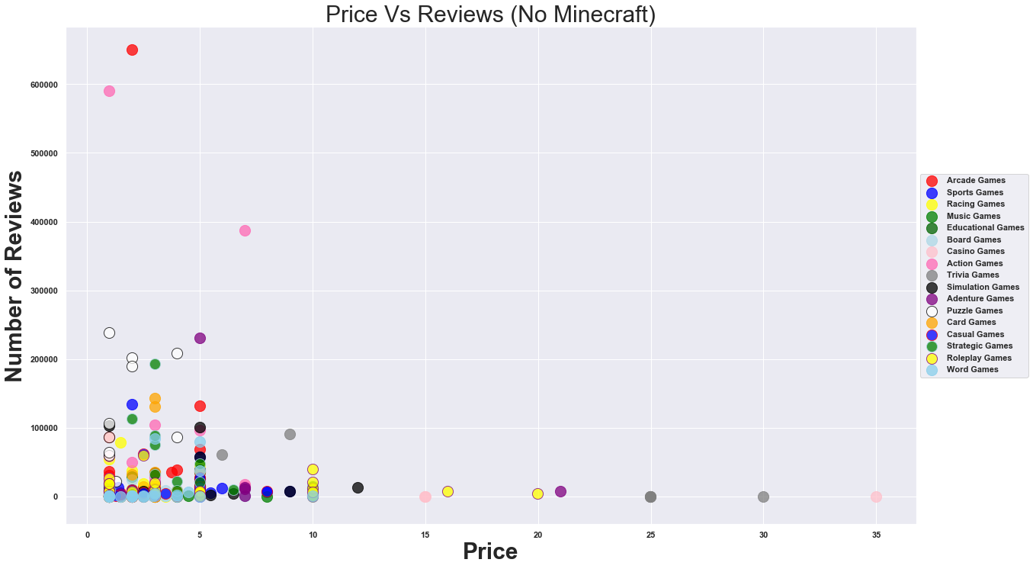
It looks like they...might?
Game Score vs Total Revenue
Game Price vs Amount of Reviews
This scatter plot appears to show a trend which indicates that there is a correlation between the review score and the total revenue of the game.
This scatter plot appears to show a correlation between the price of the game and the likelihood that the game will be reviewed.

Slide 18
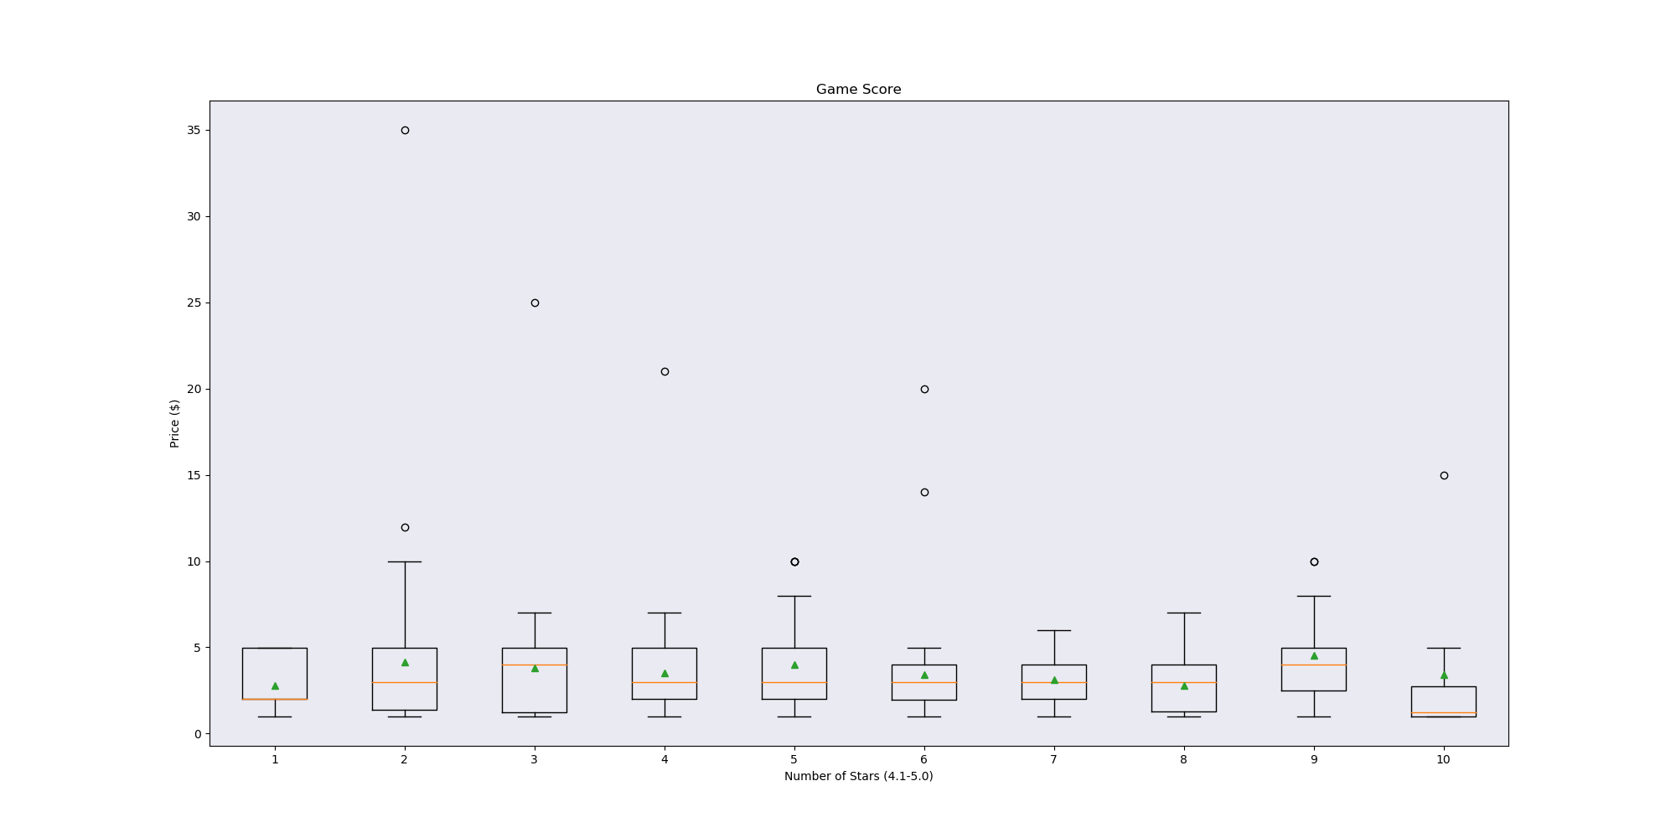
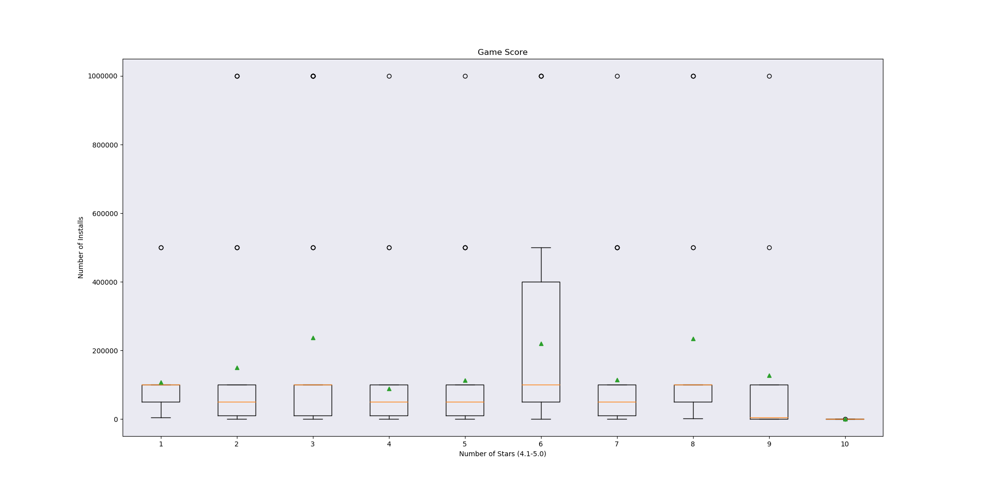
Deeper Analysis
Rating vs Price
Rating vs Installations

Slide 19
Our Conclusion:
Based on available information, if they develop a game in the ‘Action’ or ‘Arcade’ categories, at a price point of $2.99 or $4.99, they are likely to have a better chance of success.

Slide 20
Fin.

